Slide 1

Student Performance Analysis and Prediction Using Machine Learning
NAME:R.Harsha Vardhani
RegdNo:Y22ACM467
Dept:AIML
Section:B

Slide 2
CONTENTS:
Abstract
Existing system
Proposed system
Flow chart
Code
Screenshots
References

Slide 3
ABSTRACT:
This project predicts student academic performance using machine learning techniques.
It analyzes key factors like study hours, attendance, participation, and total score.
Models such as Linear Regression, Random Forest, and Gradient Boosting are implemented.
The Random Forest model achieved the highest accuracy in predicting final grades.
The system helps educators identify and support at-risk students through data-driven insights.

Slide 4
EXISTING SYSTEM:
In the old method, student performance is checked only by exam marks.
Teachers manually evaluate students without using any data tools.
This process takes more time and effort.
It depends on teacher’s opinion, so it may not be accurate.
Other factors like study time, attendance, or family background are not considered.
Because of this, teachers cannot find weak students early.
Overall, the system is manual, slow, and less effective.

Slide 5
PROPOSED SYSTEM:
Uses Machine Learning algorithms to predict student performance.
The system studies many factors like study time, attendance, previous grades, and family background.
It gives a data-based and accurate prediction of student results.
Helps teachers identify weak students early and give extra support.
Saves time and reduces manual work for teachers.
Shows graphs and charts to understand performance easily.
Overall, it makes the evaluation process smart, fast, and effective.

Slide 6
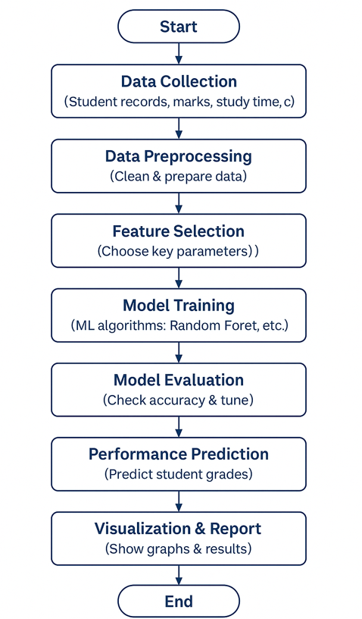
FLOW CHART:

Slide 7
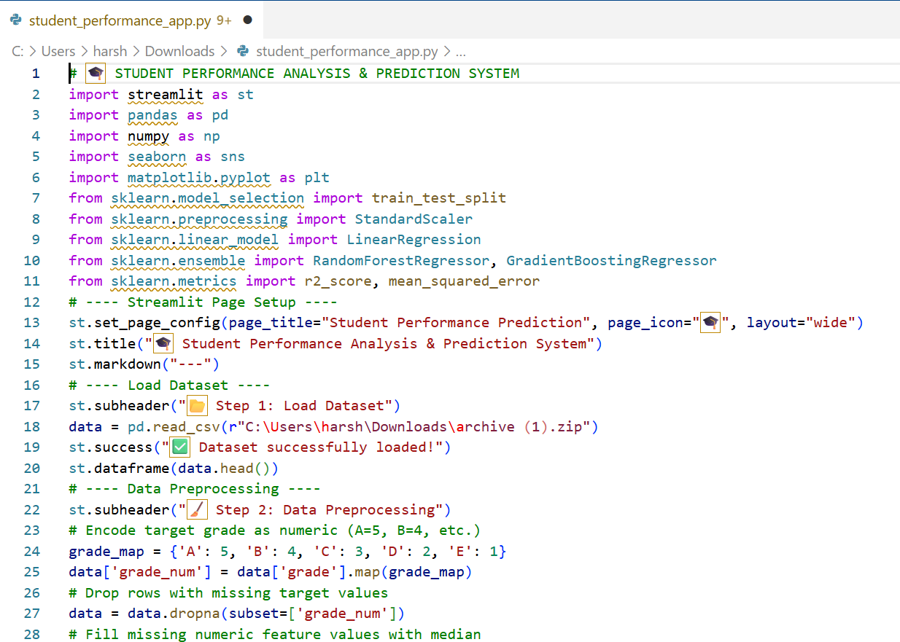
CODE:

Slide 8
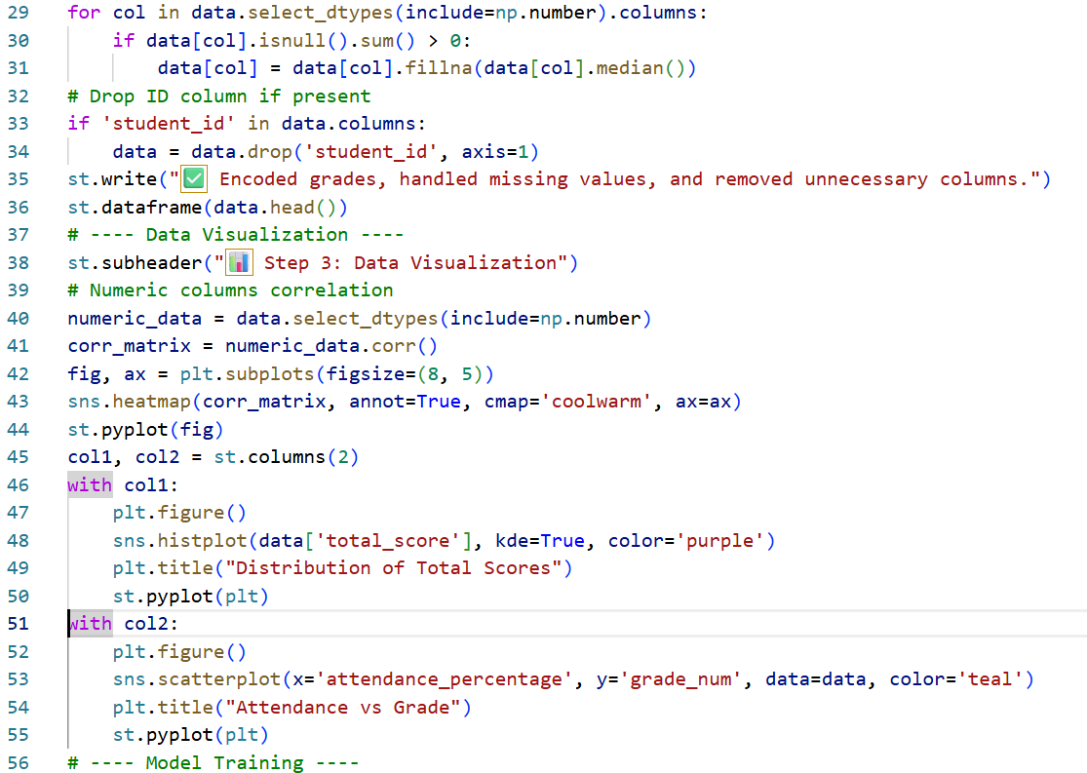

Slide 9
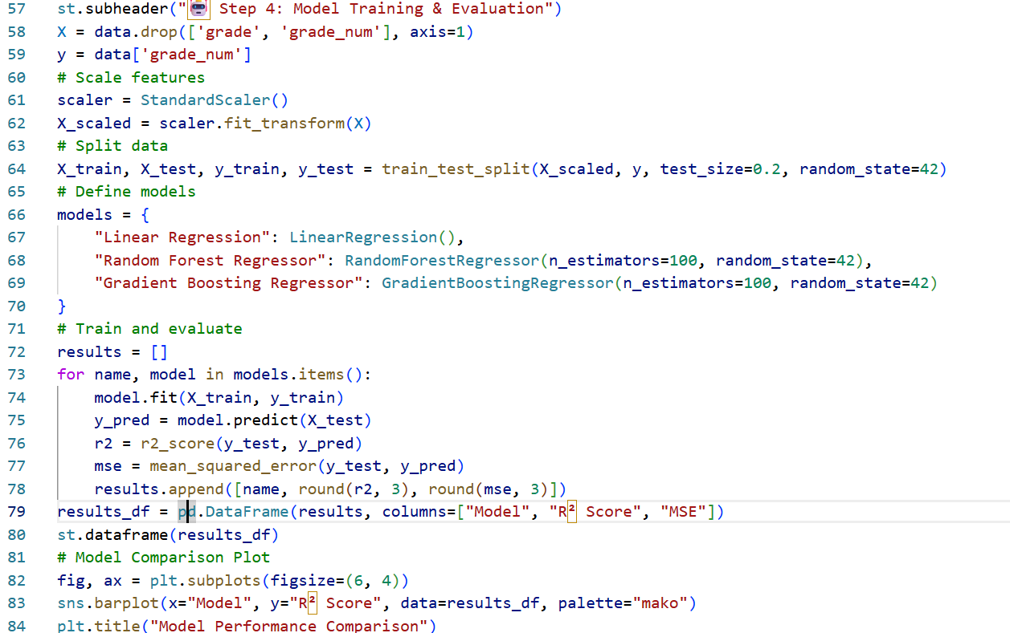

Slide 10
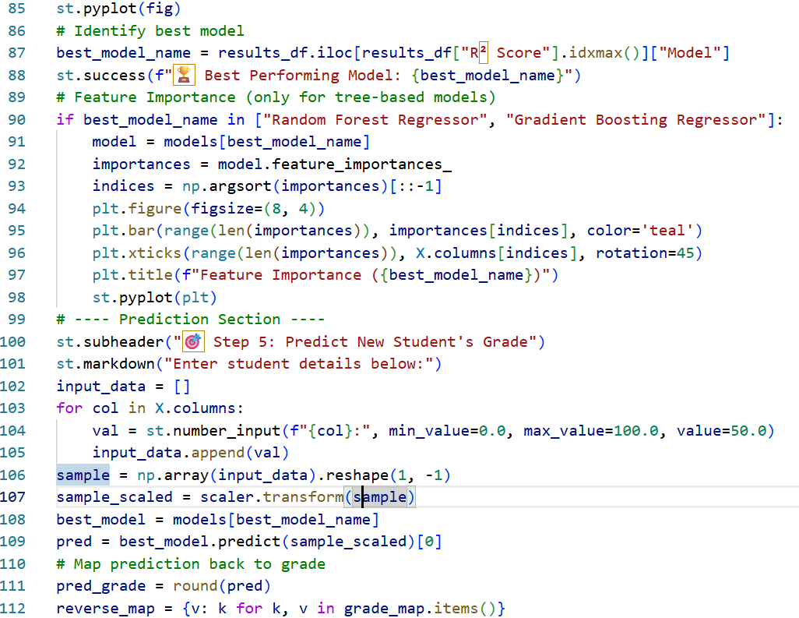

Slide 11
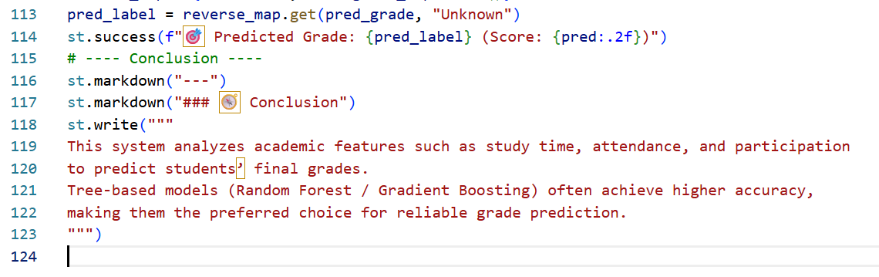

Slide 12
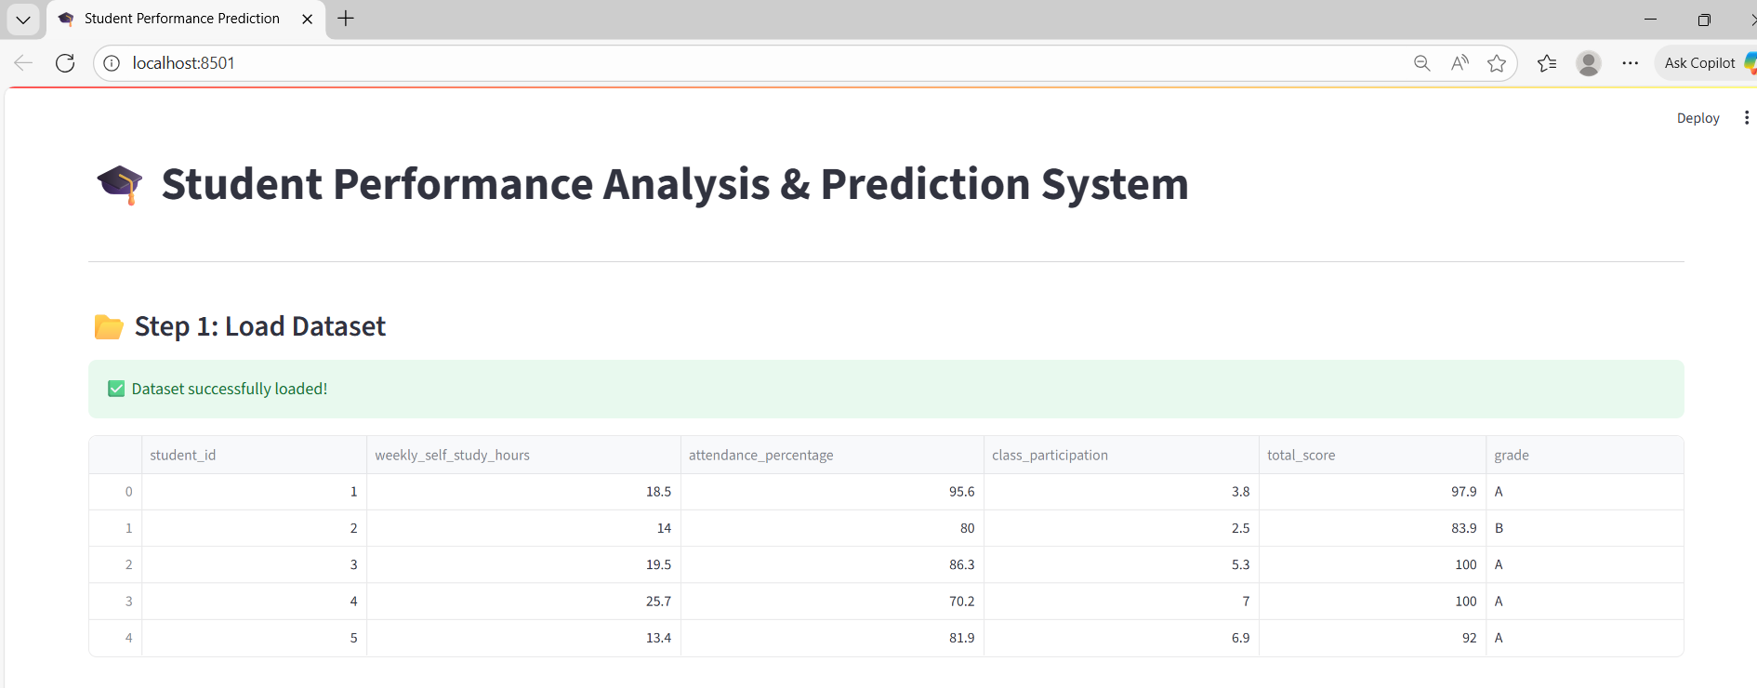
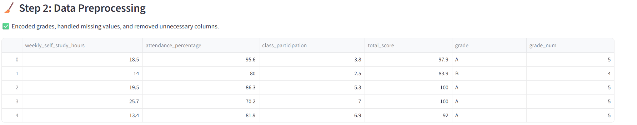
OUTPUT:

Slide 13
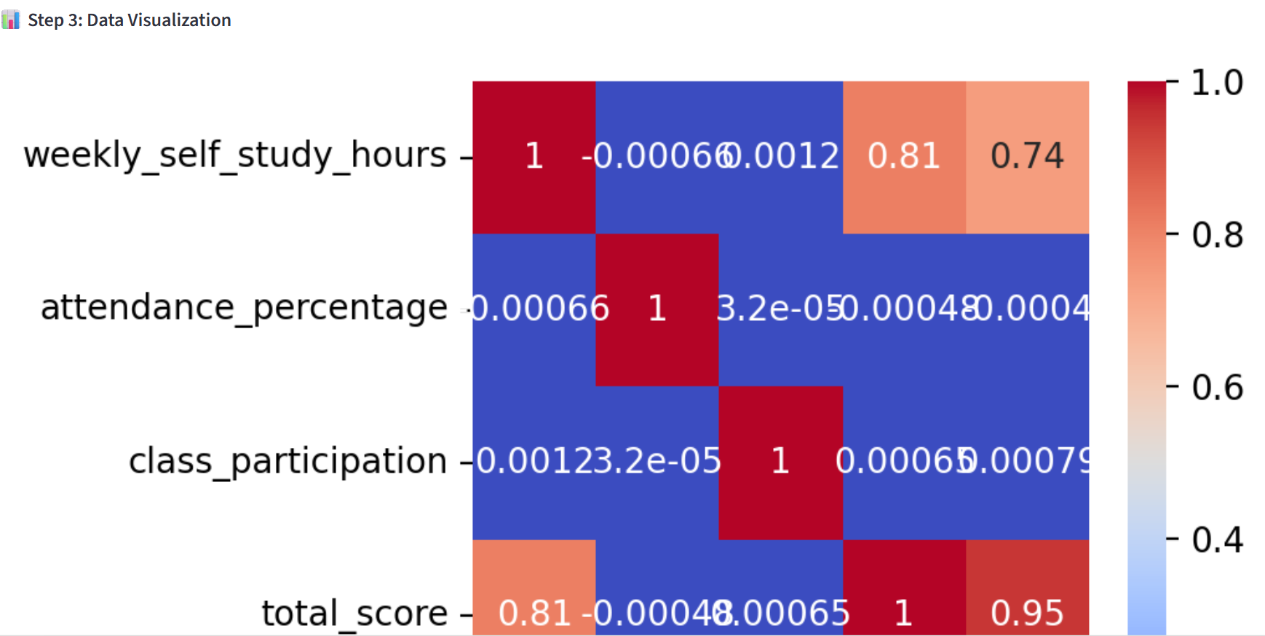
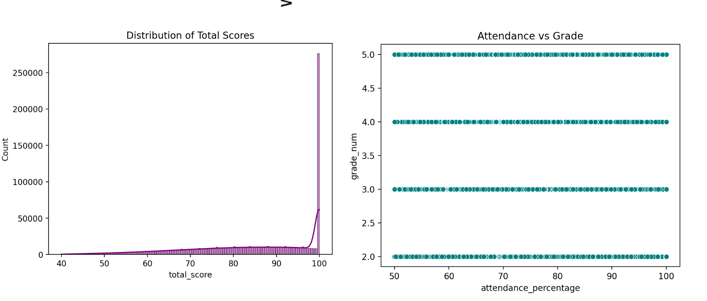

Slide 14
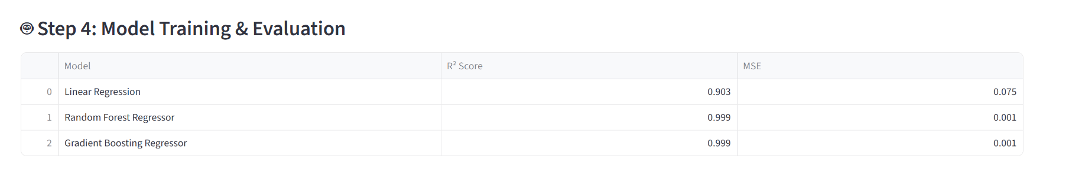
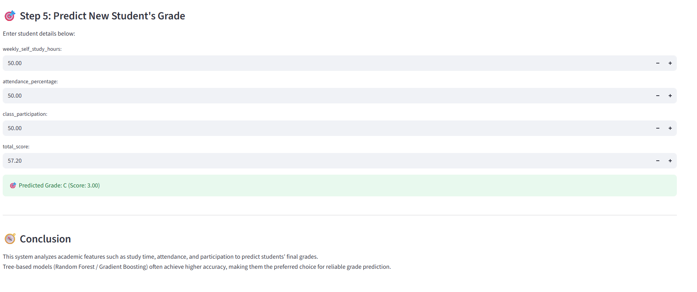

Slide 15
REFERENCE:
UCI Machine Learning Repository – Student Performance Dataset.
https://archive.ics.uci.edu/ml/datasets/Student+Performance
Scikit-learn Documentation – Machine Learning Library for Python.
https://scikit-learn.org/
Seaborn and Matplotlib Documentation – Data Visualization Tools for Python.
https://seaborn.pydata.org/,https://matplotlib.org/
IEEE Research Paper (2023) – Machine learning lfor Educational Data Analytics.
https://ieeexplore.ieee.org/
Kaggle – Student Performance Data and Analysis Projects.
https://www.kaggle.com/

Slide 16
THANK YOU!

